Slide 1

Image Classification
Rajesh Kumar Naik
Regis University

Slide 2
Purpose Statement
Definition of Image classification and other terms
How to leverage tools and libraries like TensorFlow, Keras and more
How to build, train and evaluate a neural network.

Slide 3
What is Image classification?
Image classification is a task that is associated with multi-label assignments.
It involves the extraction of information from an image and then associating the extracted information to one or more class labels. Image classification within the machine learning domain can be approached as a supervised learning task.

Slide 4
Libraries and Methods Used
TensorFlow: An open-source platform for the implementation, training, and deployment of machine learning models.
Keras: An open-source library used for the implementation of neural network architectures that run on both CPUs and GPUs.
Pandas: Data analysis and modification library.
MatplotLib: Tool utilized to create visualization plots in Python such as charts, graphs and more
Numpy: Enables several mathematical computations and operations of array data structures.

Slide 5
Model Creation
Keras provides tools required to implement the classification model. Keras presents a Sequential API for stacking layers of the neural network on top of each other
Each image input data is converted or flattened into a 1D array. The Dense layers have a defined number of neurons/units, and the amount of units is passed in as the first argument. Each dense layer also has a second argument that takes in the activation function to be utilized within each layer.
The first three layers use the ReLU activation function, while the last layer uses a softmax activation.

Slide 6
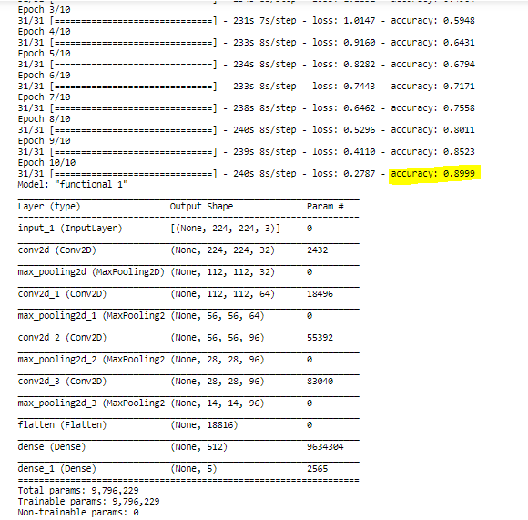

Slide 7
References-
Data set- https://www.kaggle.com/alxmamaev/flowers-recognition
https://www.tensorflow.org/tutorials/images/classification
https://towardsdatascience.com/in-depth-machine-learning-image-classification-with-tensorflow-2-0-a76526b32af8

